Slide 1

Edge Computing Software with YOLOv3
TESTWORKS
AI개발팀 강 응 찬
yeschan@testworks.co.kr
Copyright ⓒ TESTWORKS Artificial Intelligence Lab. All rights reserved.

Slide 2
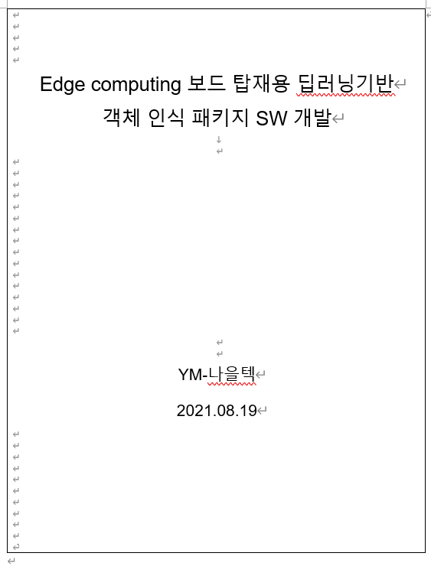
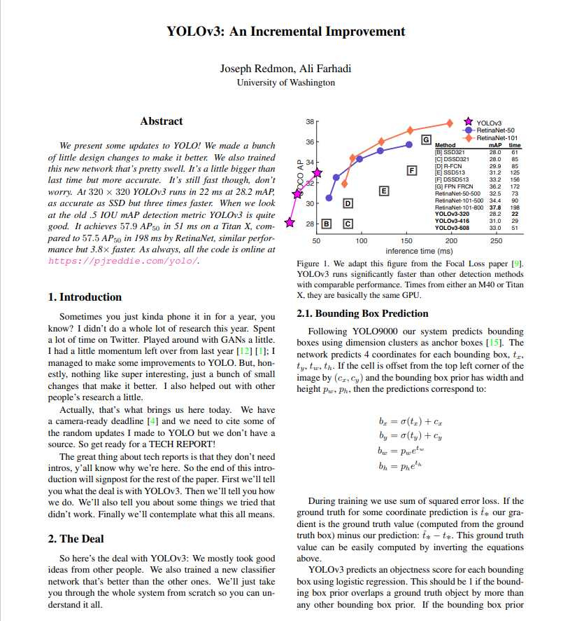
TESTWORKS
List of contents
Edge computing software 설명
YOLOv3 설명
anchor box build
bounding box prediction
class prediction
feature extract
Edge에 모델 탑재

Slide 3

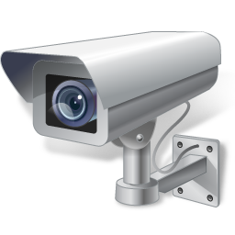


TESTWORKS
Edge computing software
Library 생성
Board
without GPU

Slide 4
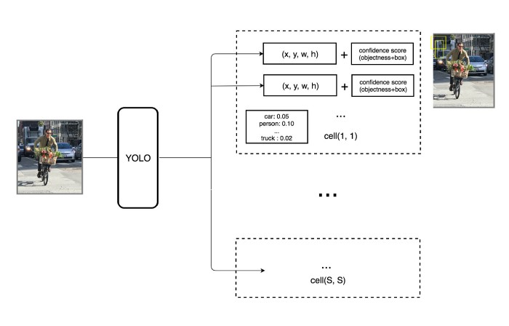
TESTWORKS
YOLOv3
MS COCO
Class : 80
Batch : 64
Epochs = 200
https://jonathan-hui.medium.com/real-time-object-detection-with-yolo-yolov2-28b1b93e2088

Slide 5
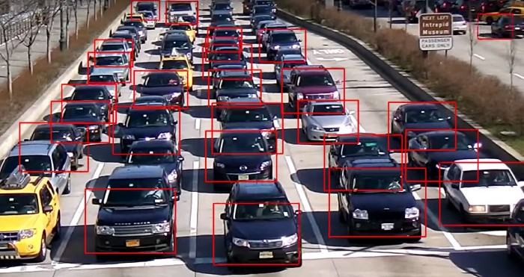
TESTWORKS
YOLOv3
In the real-life domain, the boundary boxes are not arbitrary. Cars have very similar shapes and pedestrians have an approximate aspect ratio of 0.41

Slide 6
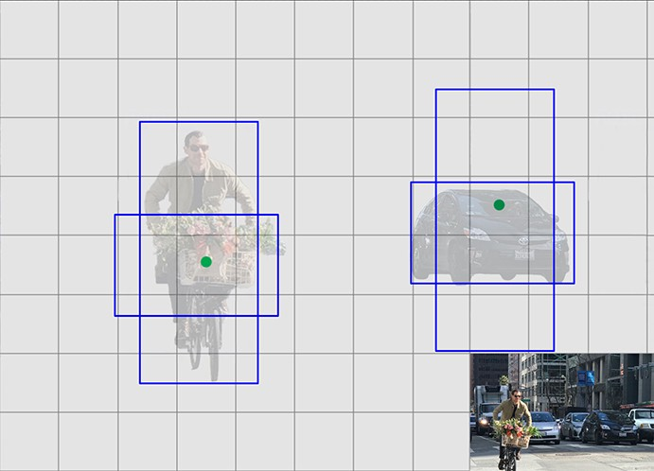
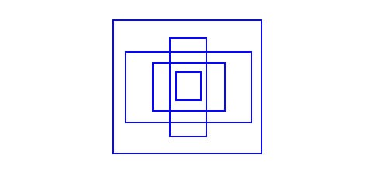
TESTWORKS
YOLOv3
anchor boxes using K-means clustering with IOU(Intersection over Union)
(10×13),(16×30),(33×23)
(30×61),(62×45),(59× 119)
(116 × 90), (156 × 198), (373 × 326)

Slide 7
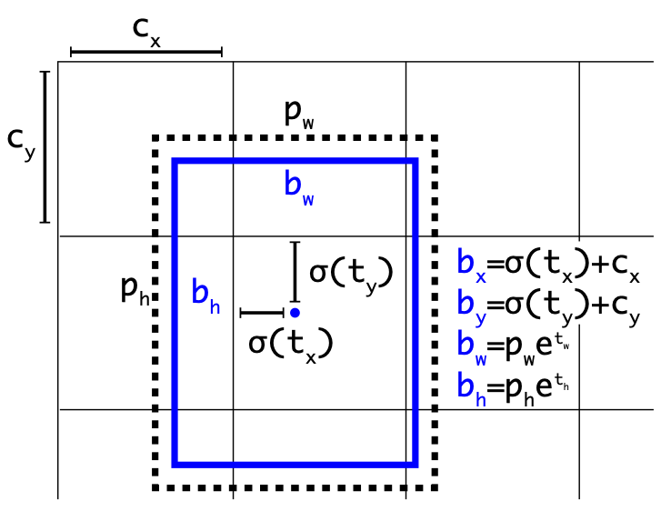
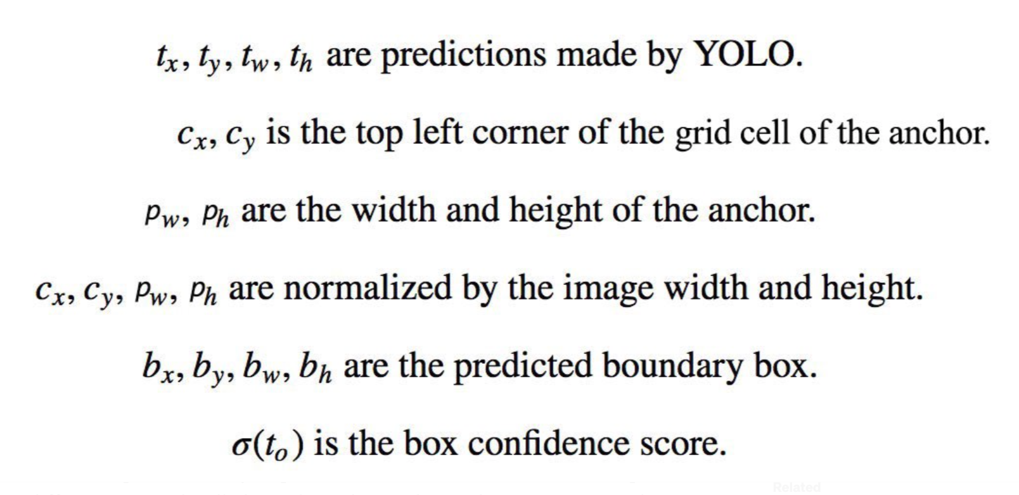
TESTWORKS
YOLOv3
Bounding Box Prediction
S × S × ((x, y, w, h, confidence_score) + classes)
13 × 13 × 9 × (1 + 4 + 80)

Slide 8
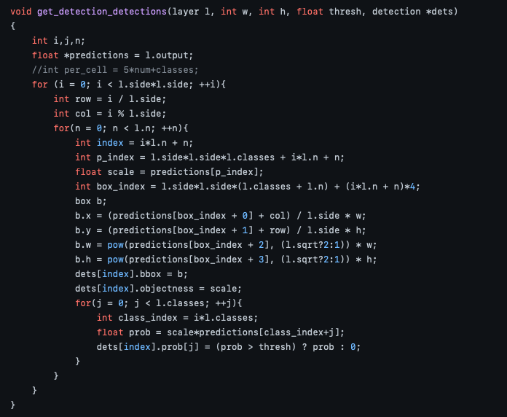
TESTWORKS
YOLOv3
Bounding Box Prediction
detection_layer

Slide 9
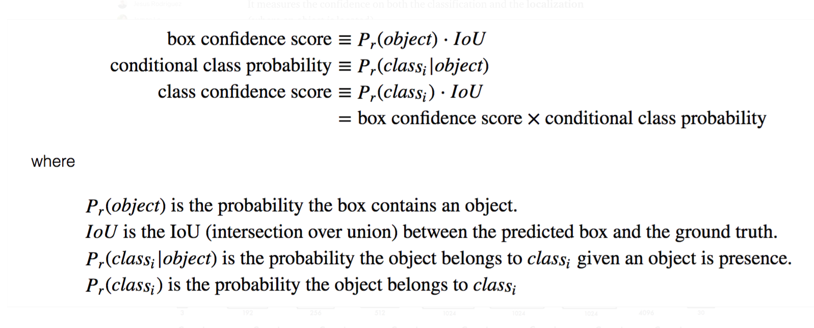
TESTWORKS
YOLOv3
Class confidence score

Slide 10
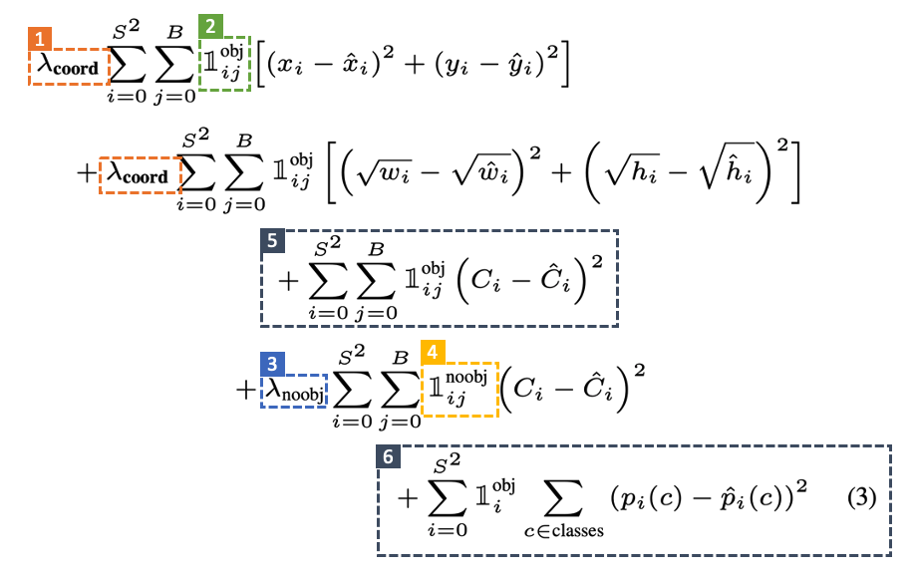
TESTWORKS
YOLOv3
Loss function
Localization loss
Confidence loss
Classification loss

Slide 11
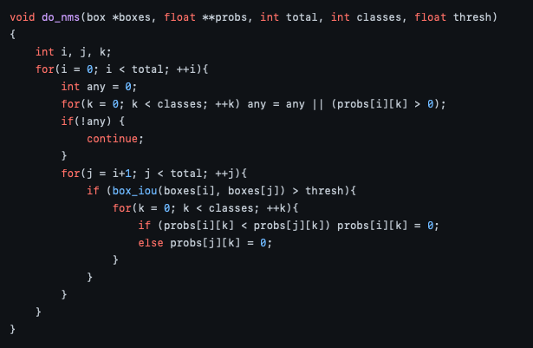
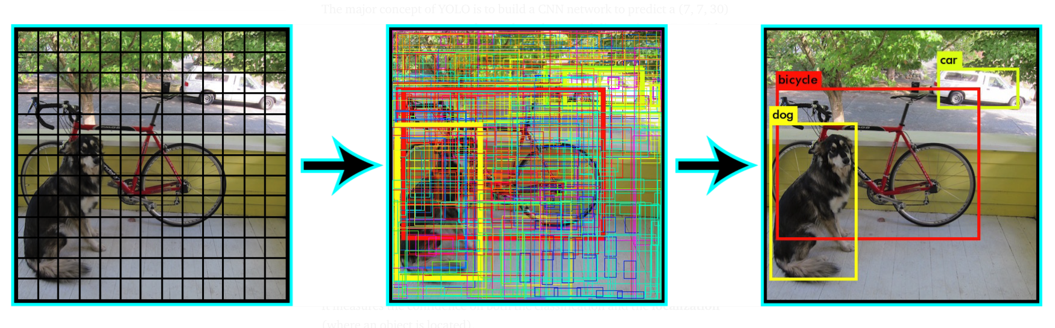
TESTWORKS
YOLOv3
Non-maximal suppression
Sort the predictions by the confidence scores
Start from the top scores, ignore any current predictions if we find any previous predictions that have the same class and IOU > 0.5 with the current prediction.
Repeat step 2 until all predictions are checked.
box.c

Slide 12
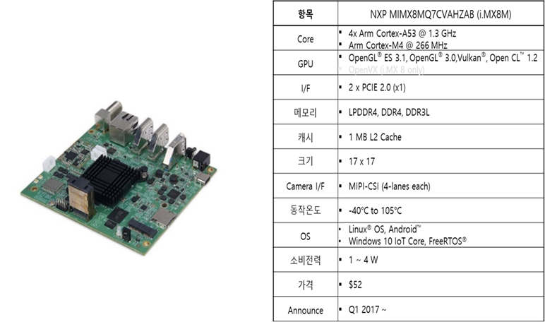
TESTWORKS
Edge board

Slide 13
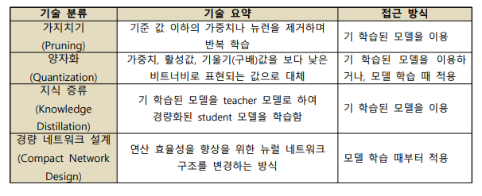
TESTWORKS
엣지 컴퓨팅을 위한 AI경량화 모델 종류

Slide 14
TESTWORKS
OpenMP API를 이용한 CPU 가속 연산
분산 메모리에서는 사용할 수 없다.
구현은 컴파일러마다 차이가 있을 수 있다.
Data Dependancy, Data Race, Deadlock 검사는 프로그래머가 해야 한다.
컴파일러가 알아서 프로그램을 병렬로 변환해 주지 않는다. 병렬화 하고 싶은 부분을 프로그래머가 직접 지정해준다.
입출력의 동기화 역시 프로그래머의 몫이다.

Slide 15
TESTWORKS
Inference engine using openMP
#ifdef YOLO_OMP_IMG_CONVERSION
#pragma omp parallel for schedule(static) num_threads(2)
#endif
for (int row = 0; row < pDst->height; ++row) {
for (int nCh = 0; nCh < pDst->channel; ++nCh) {
for (int col = 0; col < pDst->width; ++col) {
im.data[nCh * pDst->width * pDst->height + row * pDst->width + col]
= ((unsigned char)pSrc->pData[(row + clipPosRow) * pSrc->widthStep + (col + clipPosCol) * pDst->channel + nCh]) / 255.0f;
}
}
}
#else

Slide 16
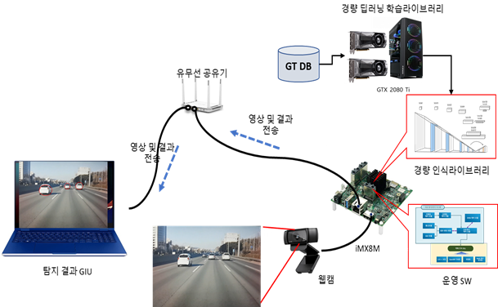
TESTWORKS
Edge computing deep learning system

Slide 17
TESTWORKS
Training Models on an Edge Device
On-Device
Learning
Hardware
Approaches
Software
Approaches
Theoretical
Approaches
Additional Resources
On chip(cpu, gpu)
Computing
Libraries
Algorithms
Performance guarantees for algorithms
Novel Architectures
(spiking networks etc)
Speed-up existing
techniques
Lightweight
Algorithms
Novel theories for resource constrained settings
Novel Techniques
Data / Model complexity reduction techniques
Novel optimization techniques
New protocols for data observation

Slide 18
TESTWORKS
Thank You.

Slide 19
TESTWORKS

